Slide 1
Numerical Analysis (6/7) Linear systems
University of Luxembourg - 2024
Master in Mathematics
Hadrien Beriot

Slide 2
Outline
1. Introduction
2. LU decomposition
3. QR decomposition
4. Iterative methods
5. Summary

Slide 3

1. Introduction

Slide 4
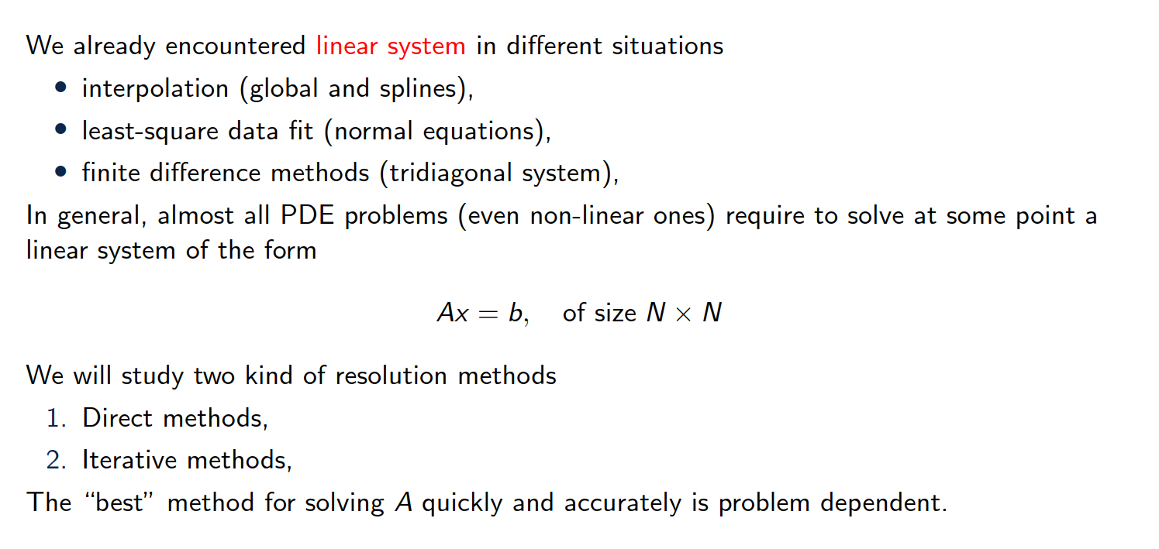
Overview of the content

Slide 5
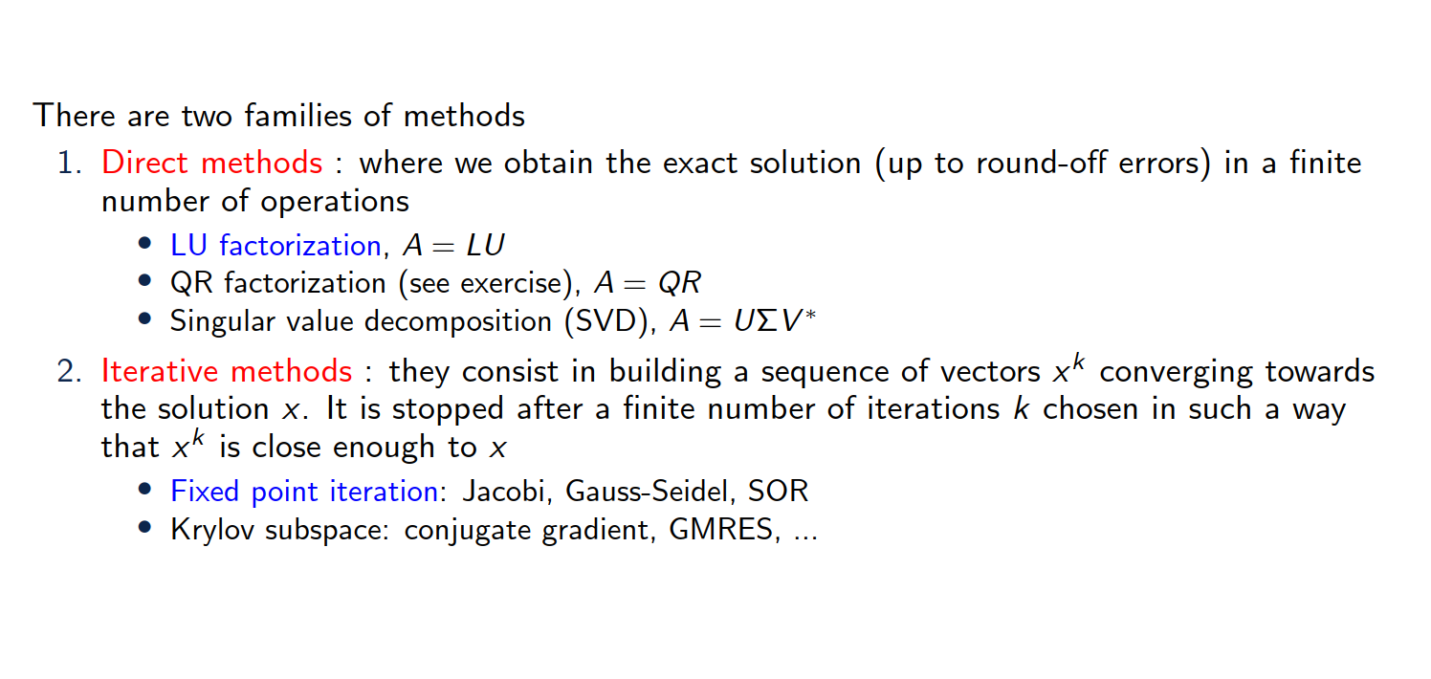
Overview of the content

Slide 6
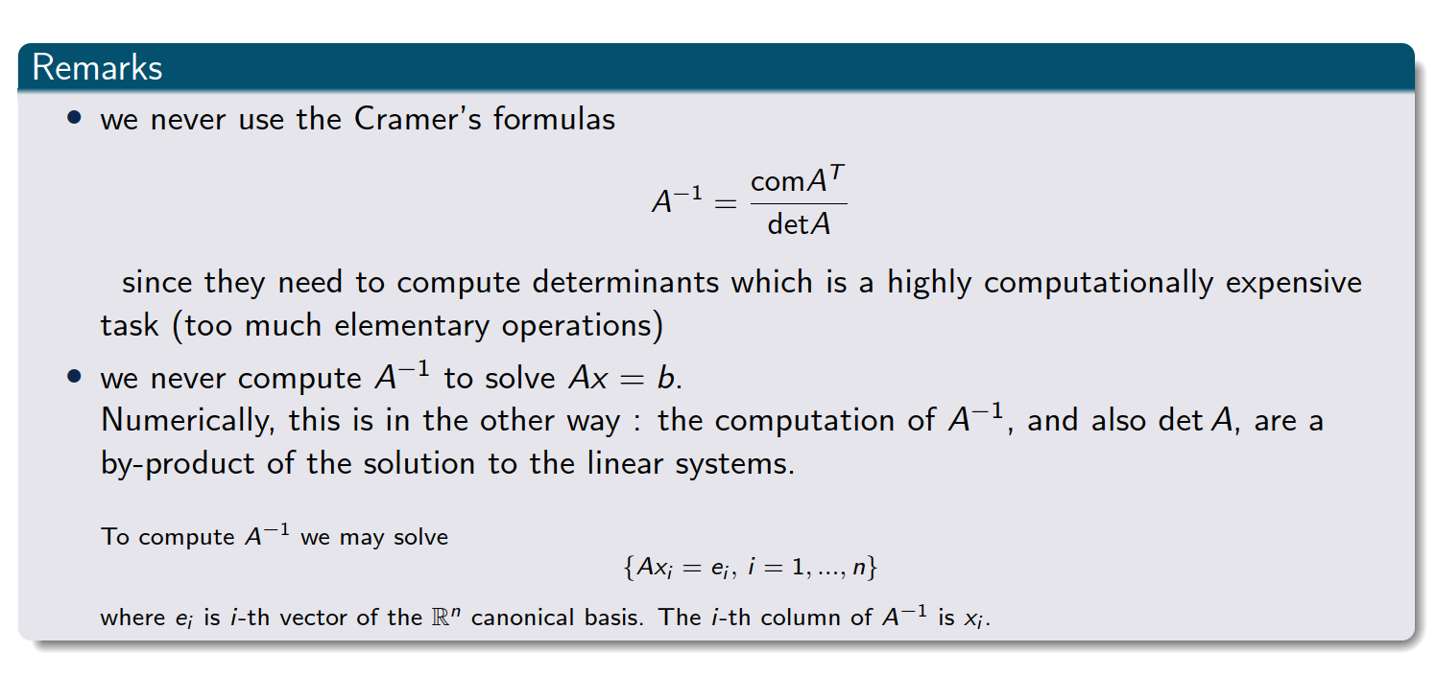
Important remarks
Notes:
The comatrix of a matrix AAA is the transpose of the matrix of cofactors of A.Each cofactor is obtained by calculating the determinant of the submatrix that remains after removing the row and column corresponding to the element in question, with an appropriate sign adjustment based on the position.

Slide 7
2. LU factorization

Slide 8
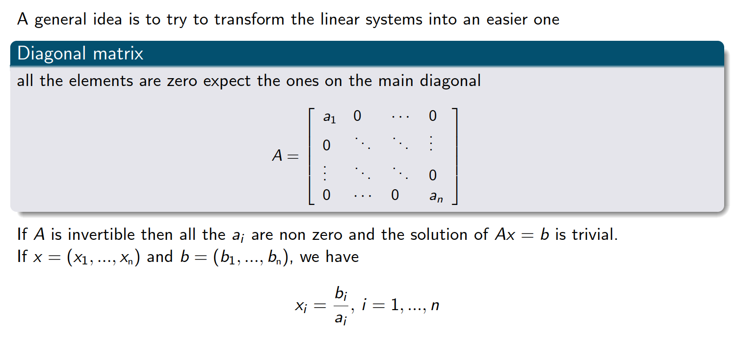
Linear system that is easy to solve

Slide 9
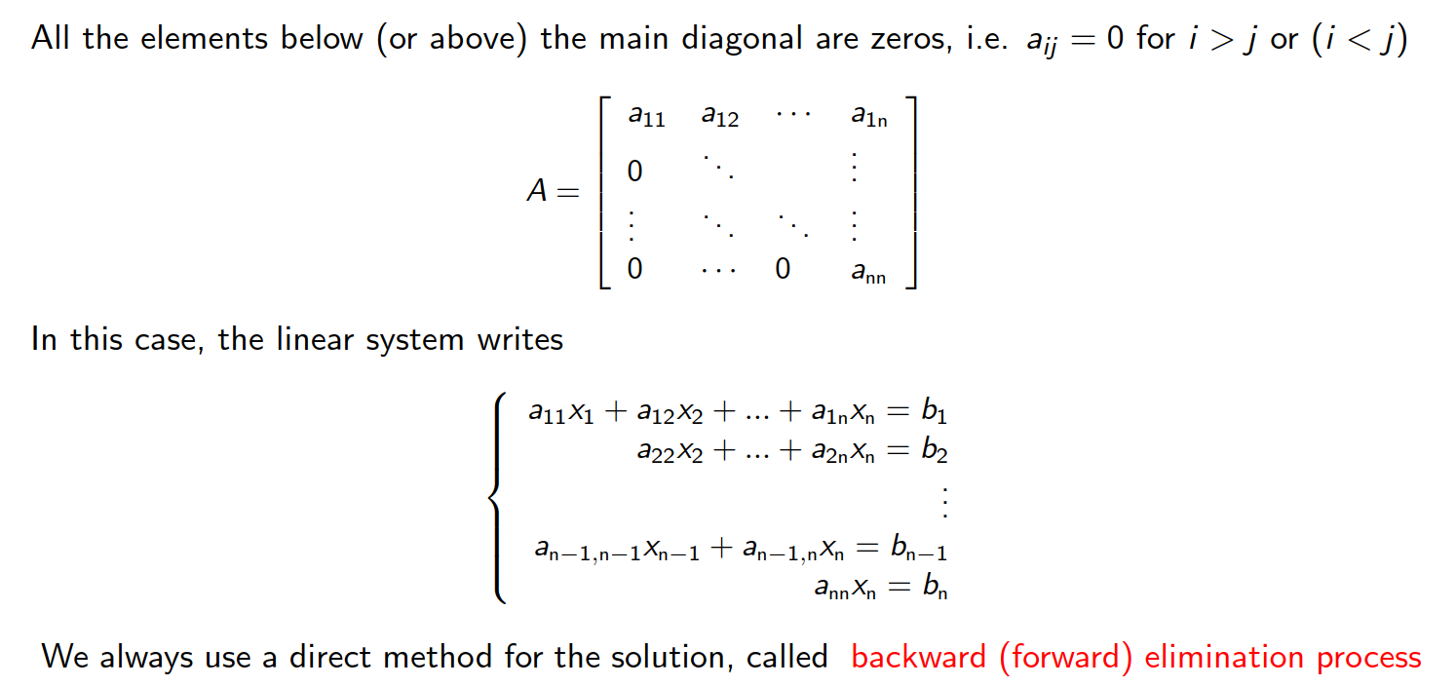
Upper (or lower) triangular matrices

Slide 10
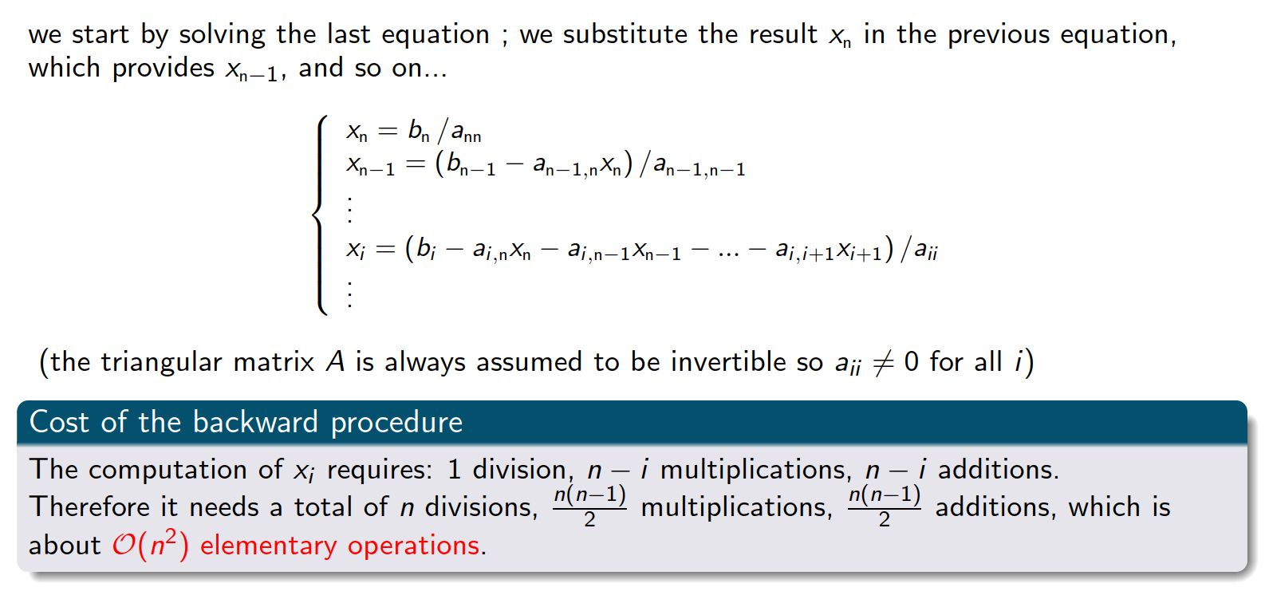
Backward substitution
Exercise 1

Slide 11
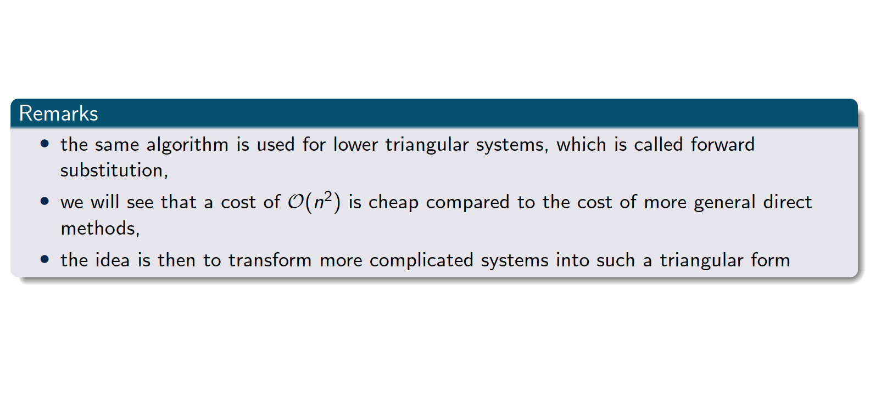
Upper (or lower) triangular matrices

Slide 12
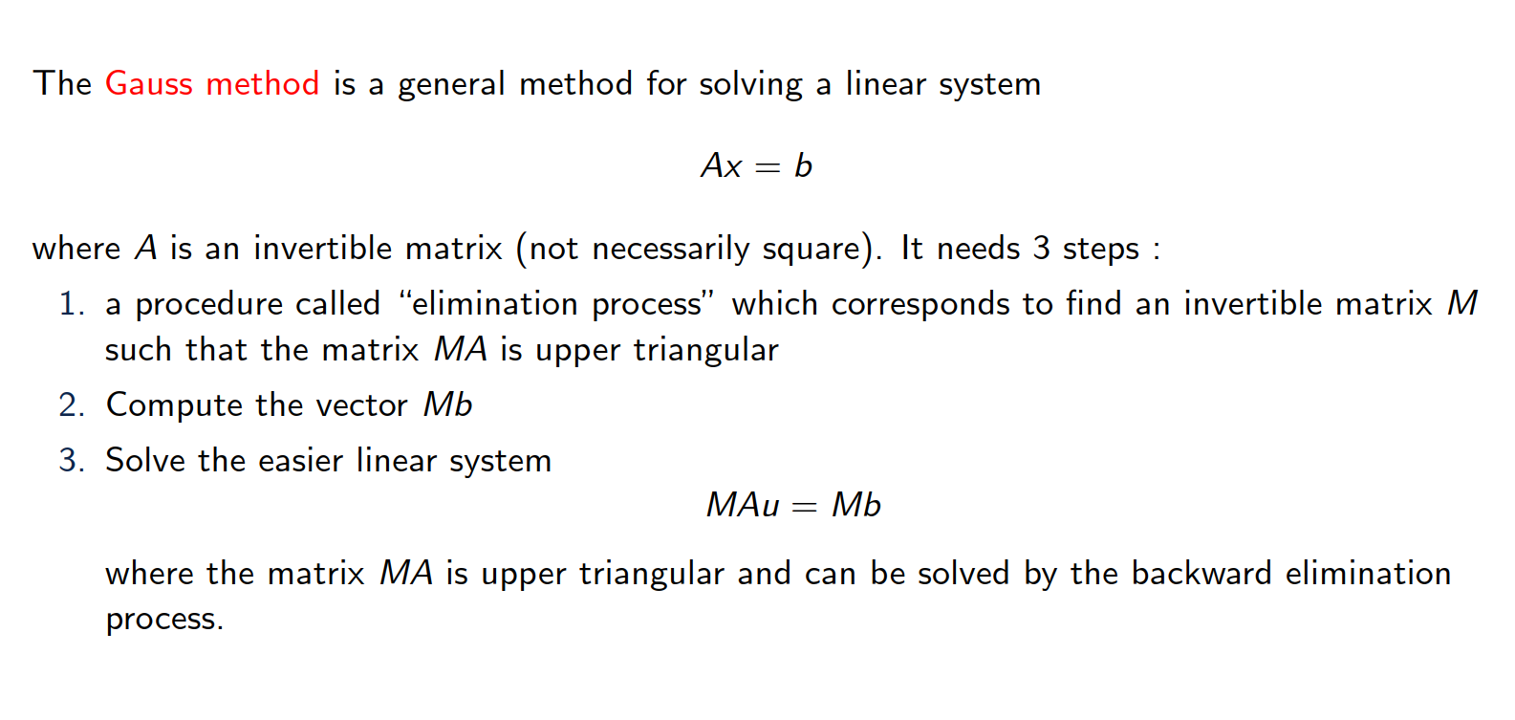
Gauss elimination

Slide 13
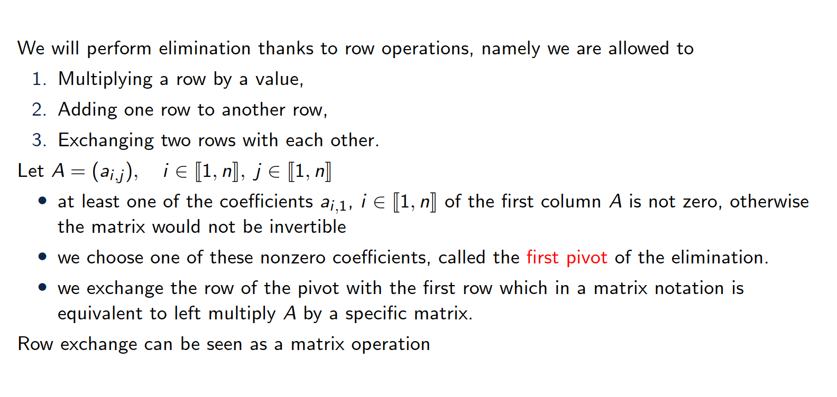
Description of the first step

Slide 14
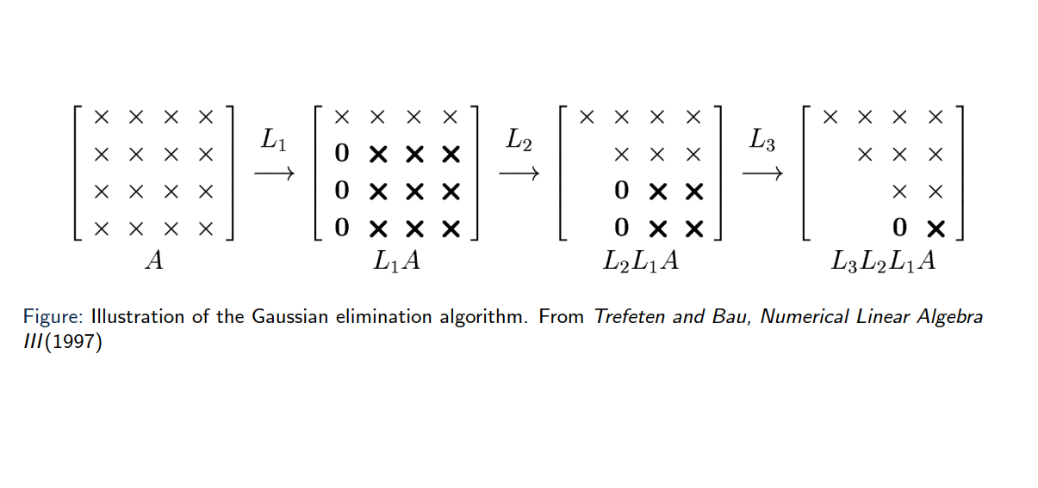
Illustration of the algorithm

Slide 15
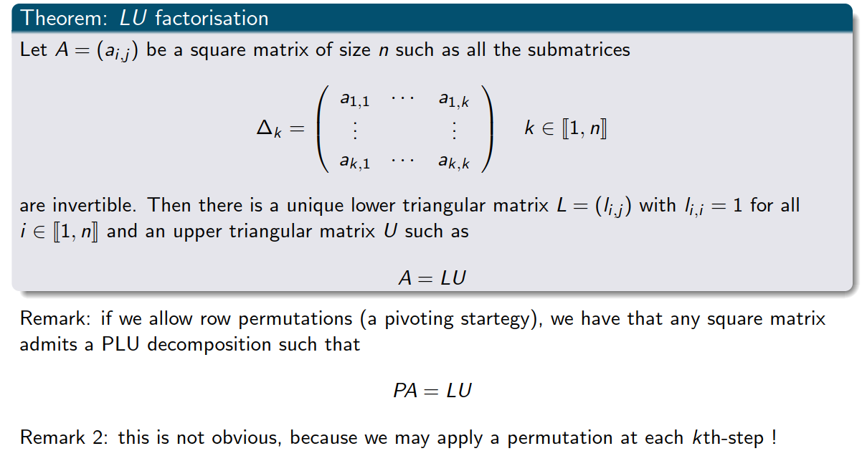
Theorem

Slide 16
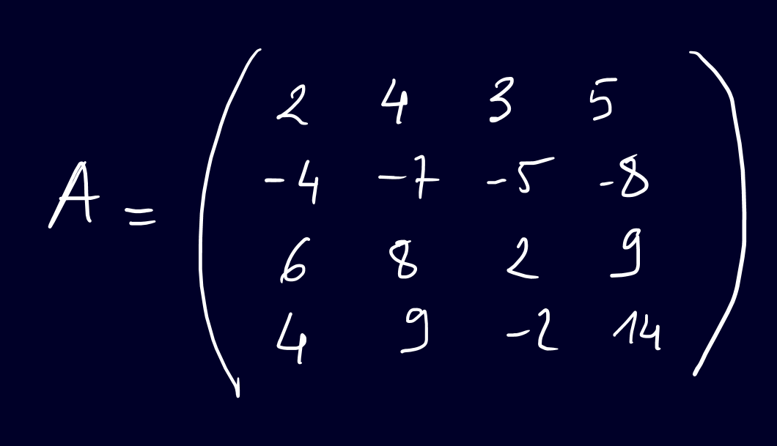
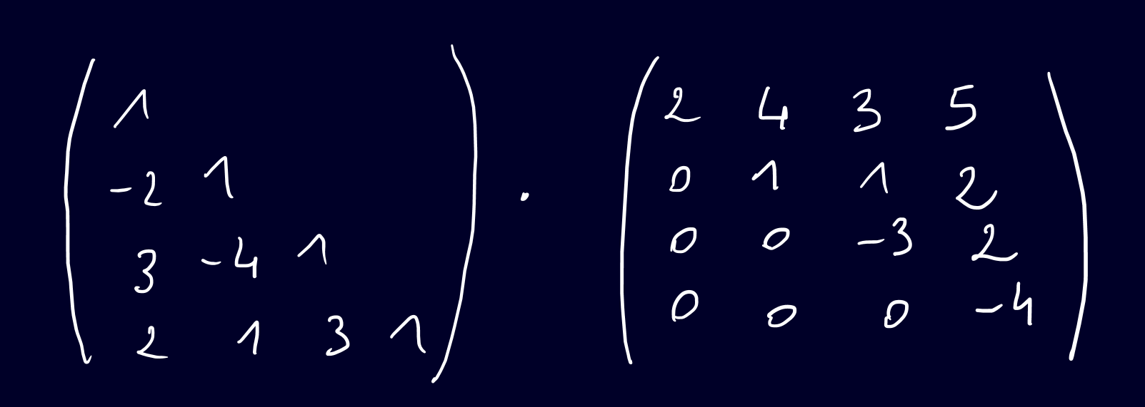



Example (hands on)
Exercise 2
Notes:
Expanded Gaussian elimination

Slide 17
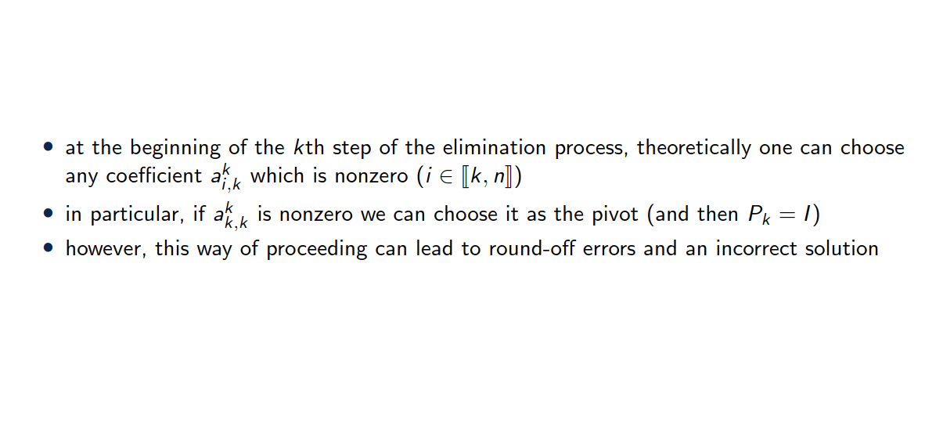
Choice of the pivot

Slide 18
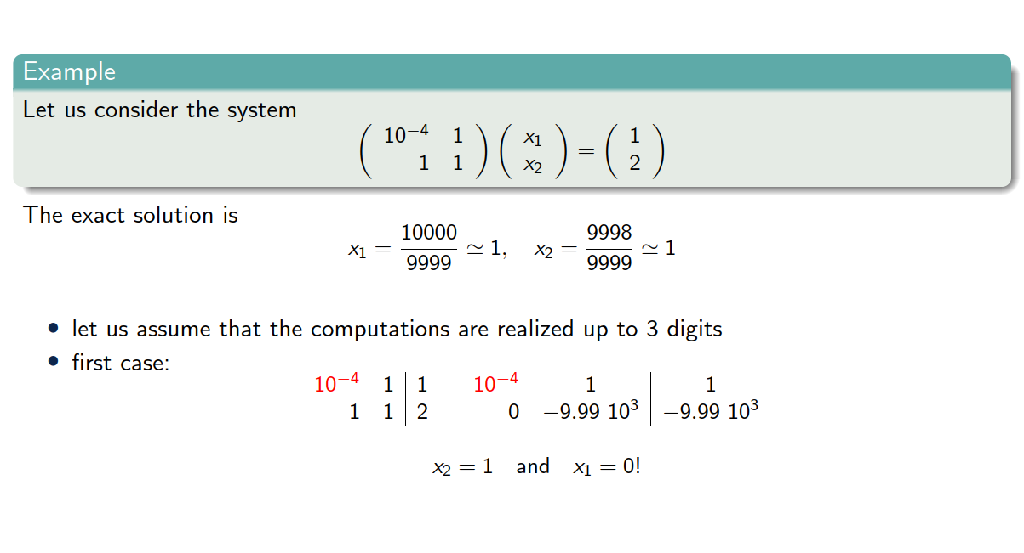
Choice of the pivot

Slide 19
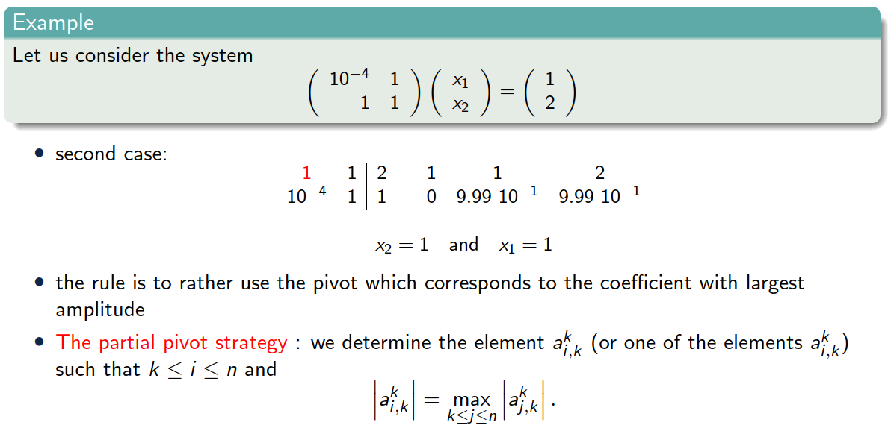
Choice of the pivot

Slide 20
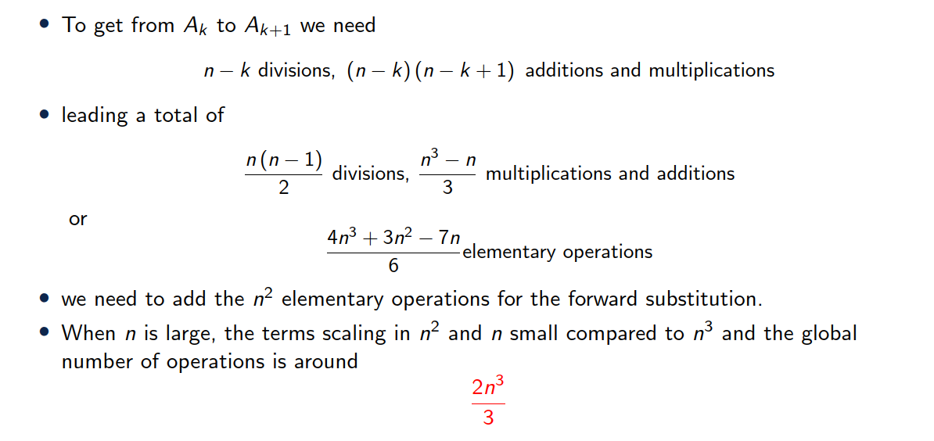
Cost of Gauss method

Slide 21
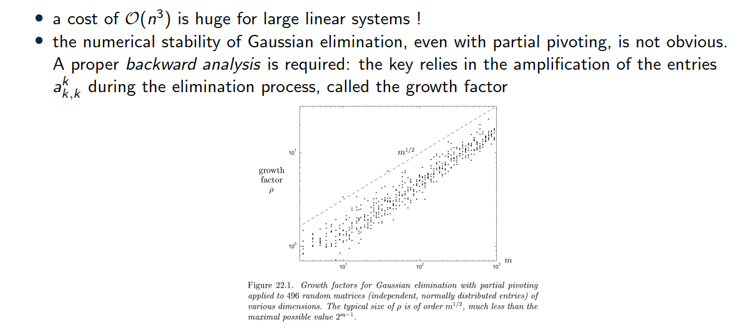
Remarks

Slide 22
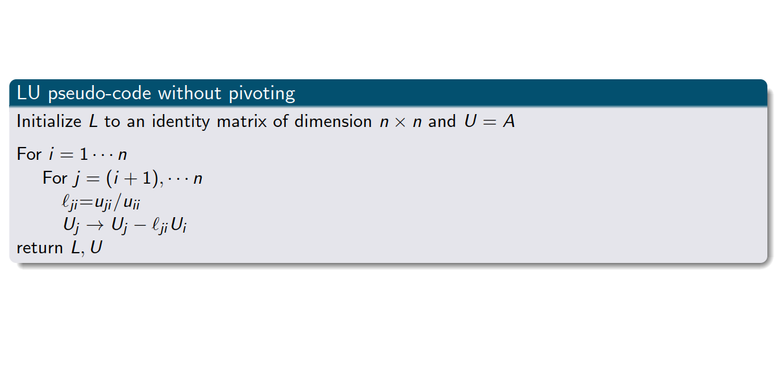
LU factorization pseudo-code
Exercise 2

Slide 23
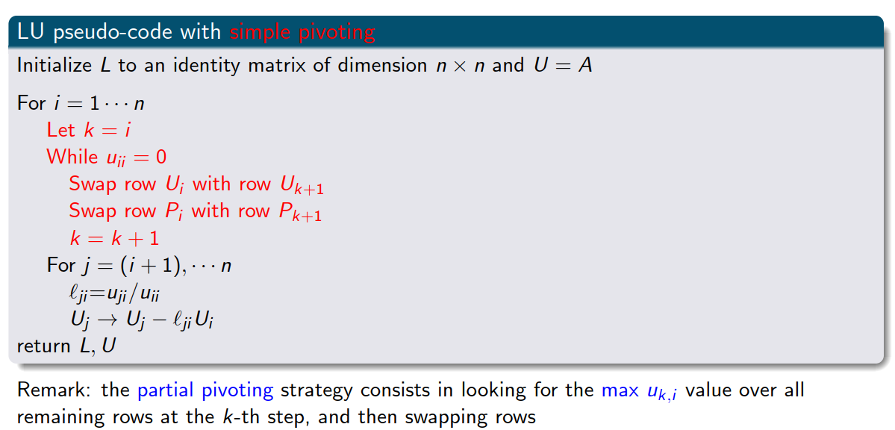
LU factorization pseudo-code with pivoting
Exercise 3

Slide 24
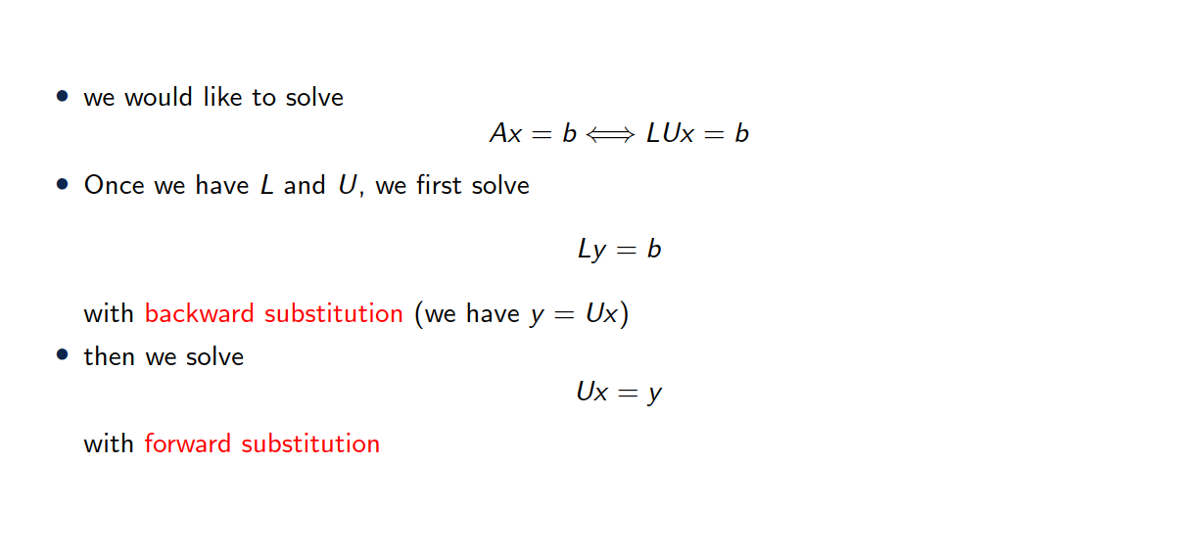
Solving a linear system with LU factorization

Slide 25
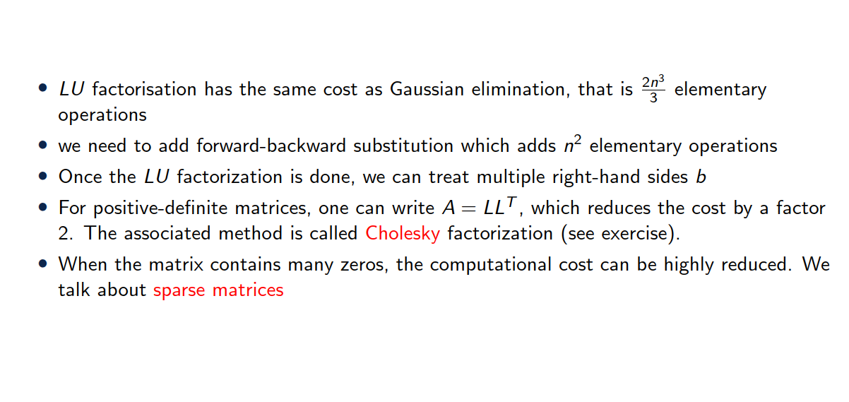
Factorization cost

Slide 26
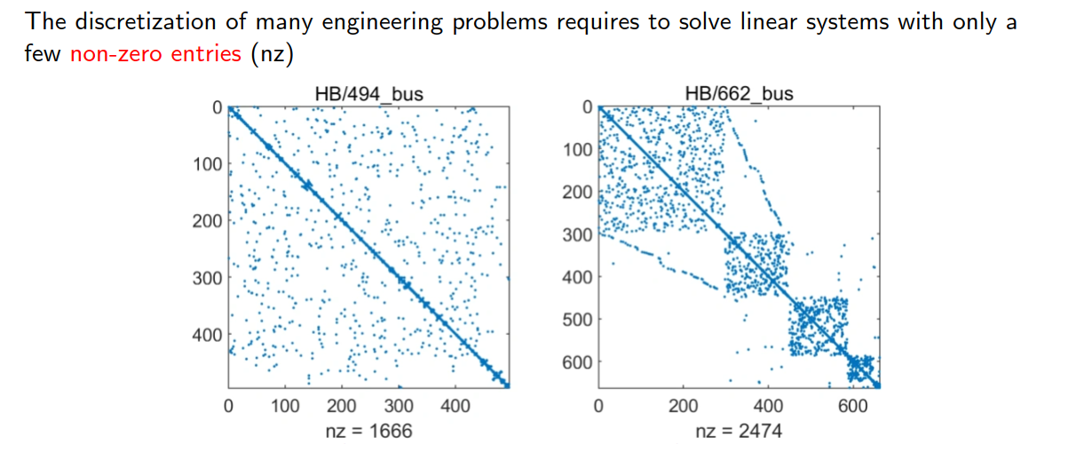
A few words on sparse matrices

Slide 27
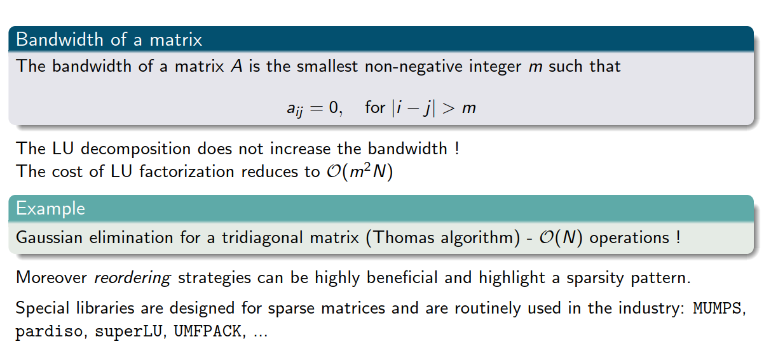
A few words on sparse matrices

Slide 28
3. QR decomposition

Slide 29
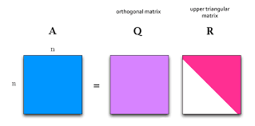

QR decomposition (for square matrices)
Definition:
Any $n×n$ matrix $A$ can be decomposed into:
$Q$: A matrix with orthonormal columns ($Q^{T}Q=I$)
$R$: An upper triangular matrix
Steps for Decomposition:
Classical Approach: Gram-Schmidt orthogonalization process.
Alternative Methods: Householder reflections or Givens rotations
Applications: Often used in least-squares problems and eigenvalue problems.

Slide 30
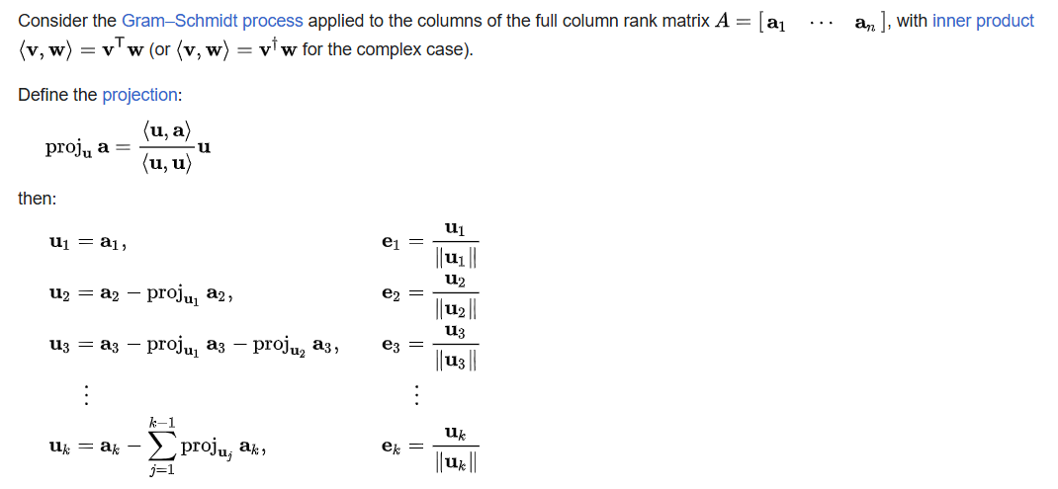
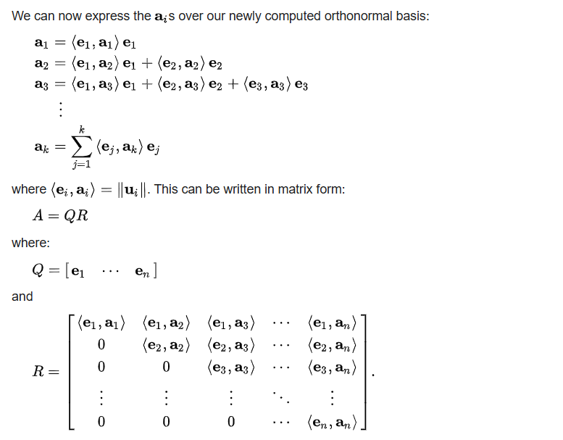
QR decomposition
https://en.wikipedia.org/wiki/QR_decomposition

Slide 31
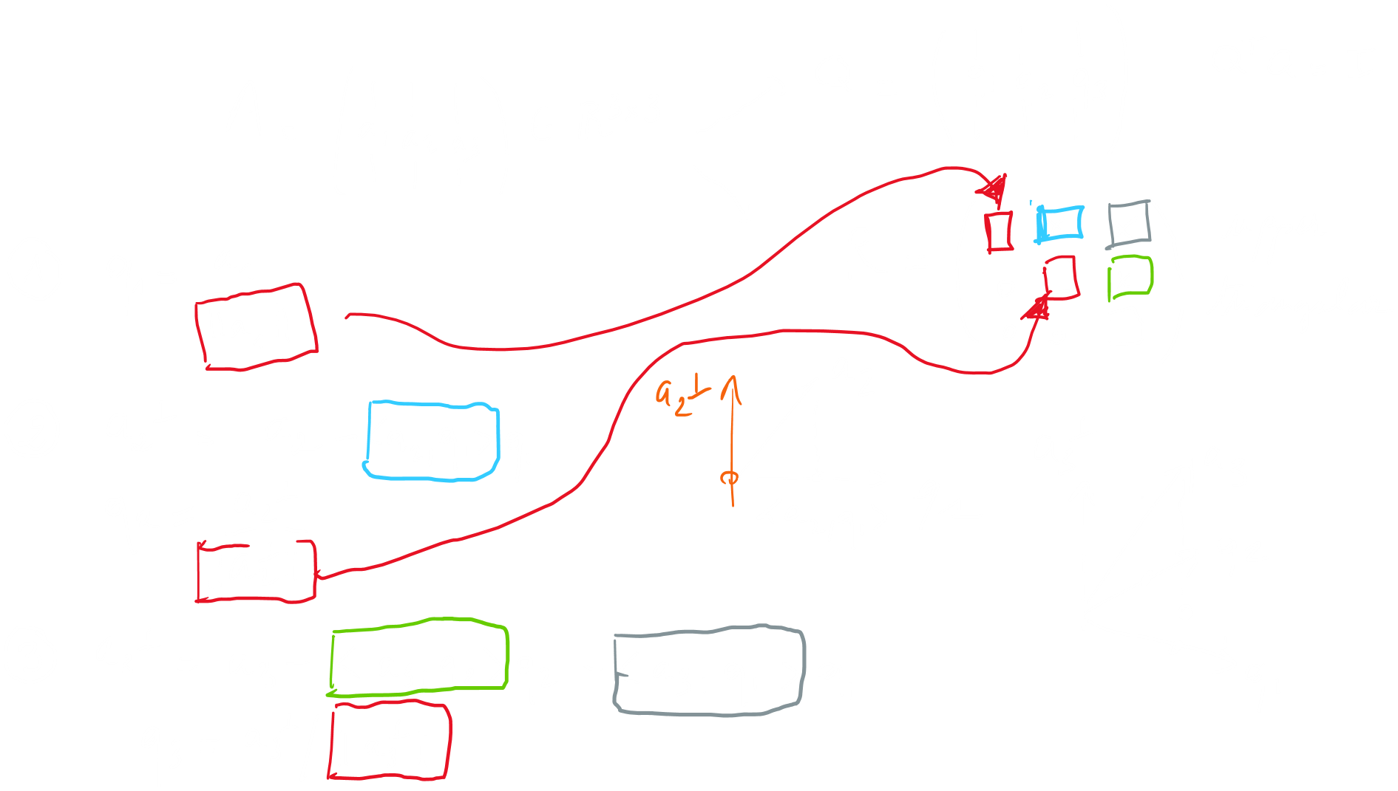
QR algorithm
The QR decomposition is based on a Gram-Schmidt orthogonalization process

Slide 32












Example (hands on)

Slide 33
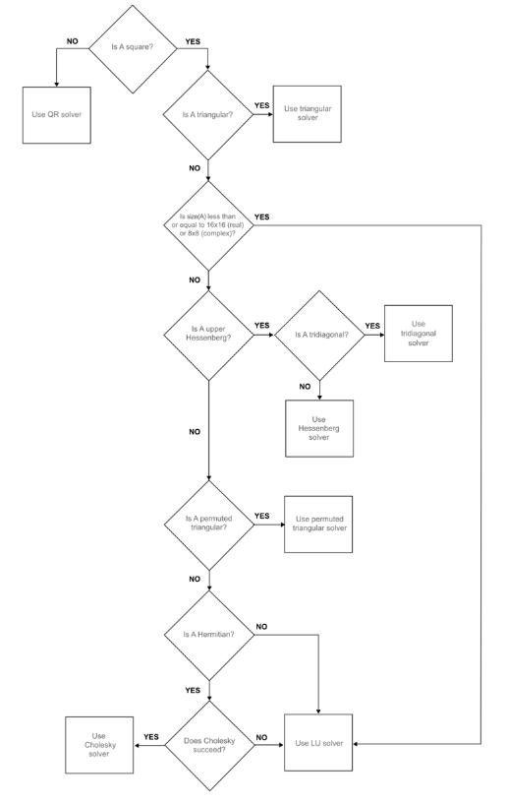
Backslah in Matlab
https://www.mathworks.com/help/matlab/ref/double.ml
divide.html
Decision tree
Use QR solver for non square matrices
Use Cholesky for square symmetric matrices
Use LU otherwise
Exercise 4

Slide 34
3. Iterative solvers

Slide 35
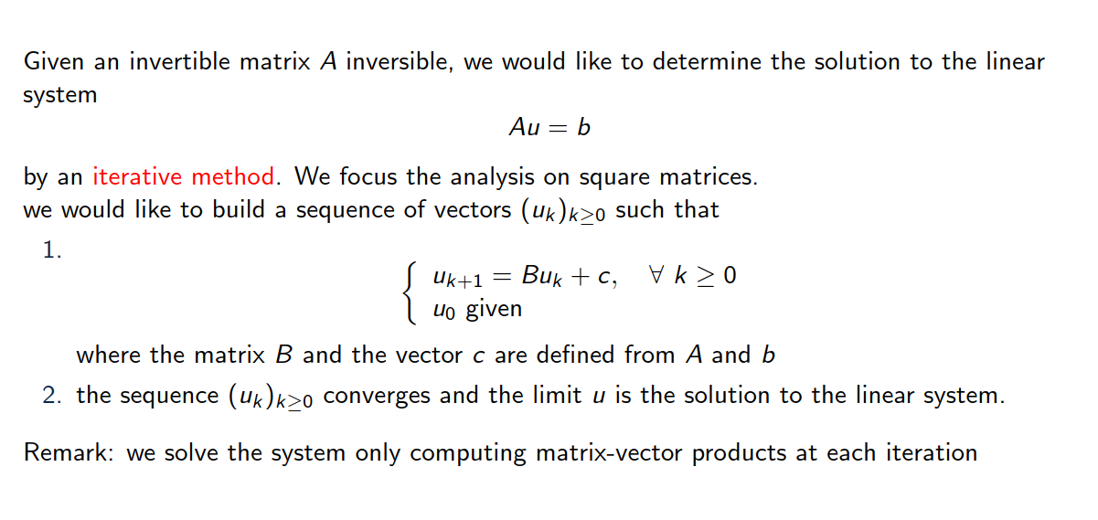
Introduction

Slide 36
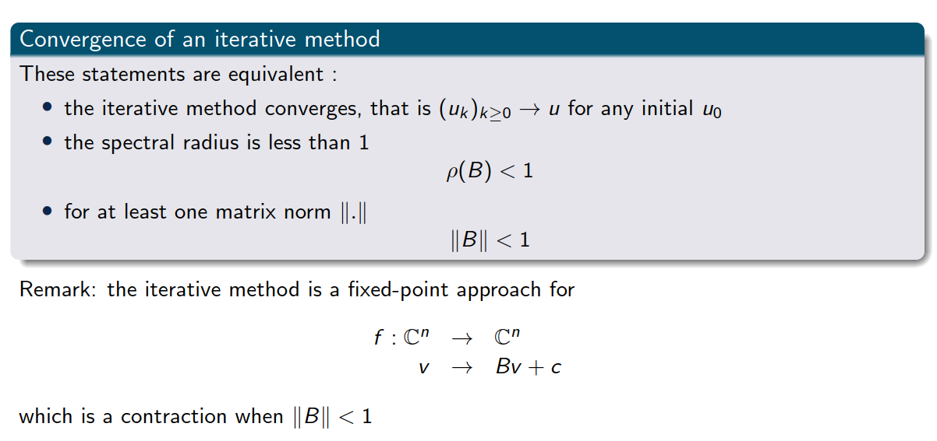
Some basic notions

Slide 37
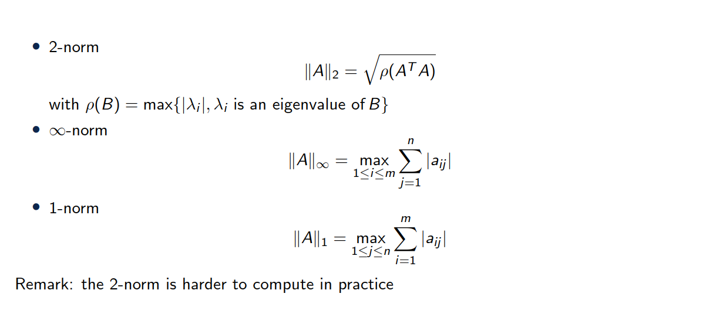
Some induced matrix norms

Slide 38
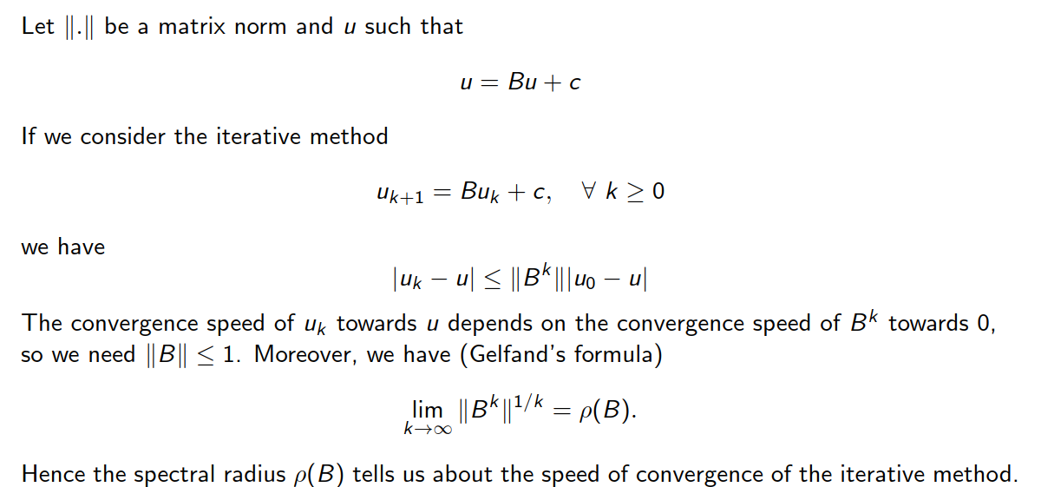
Speed of convergence

Slide 39
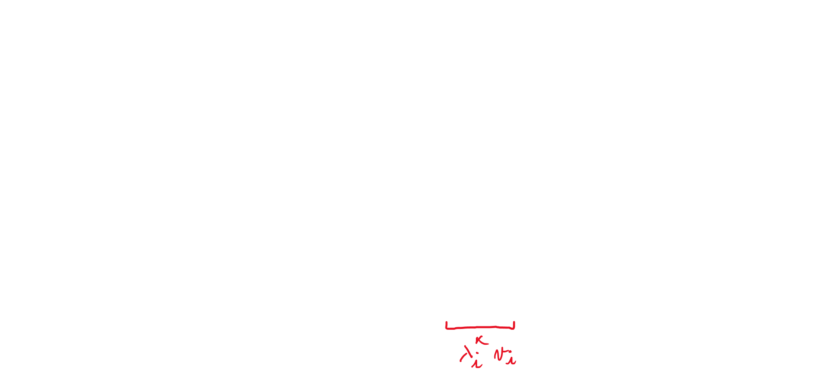



Why is spectral radius of B important?

Slide 40

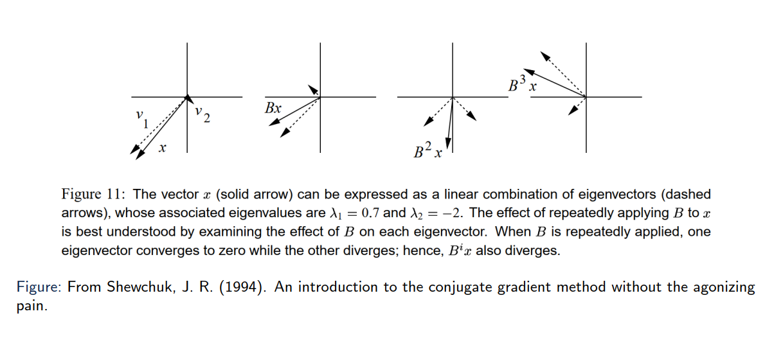
Geometrical interpretation
Eigen vectors only get scaled, not changed in direction!

Slide 41
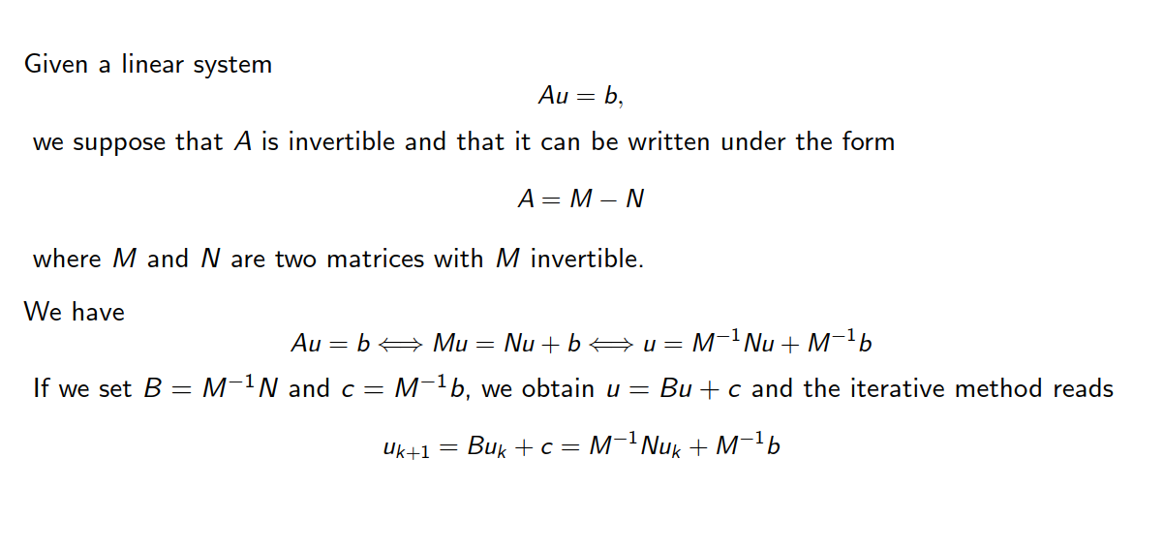
Another matrix decomposition

Slide 42
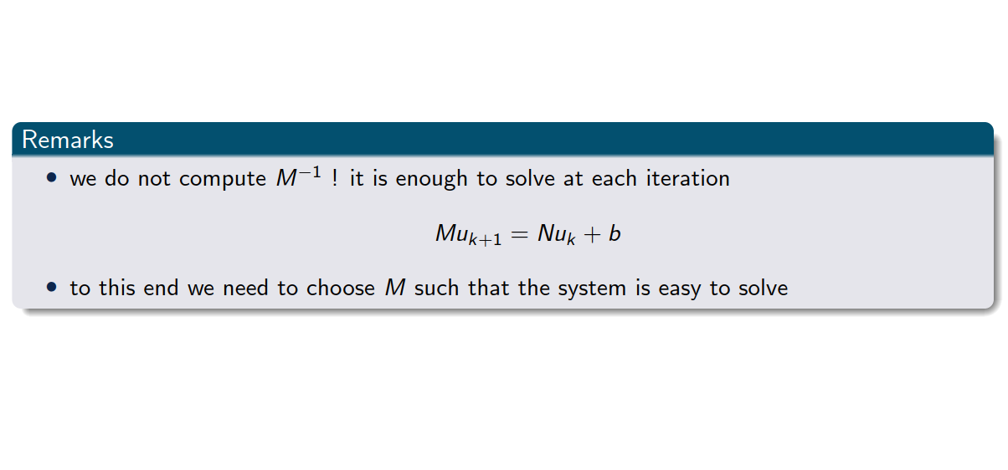
Another matrix decomposition

Slide 43
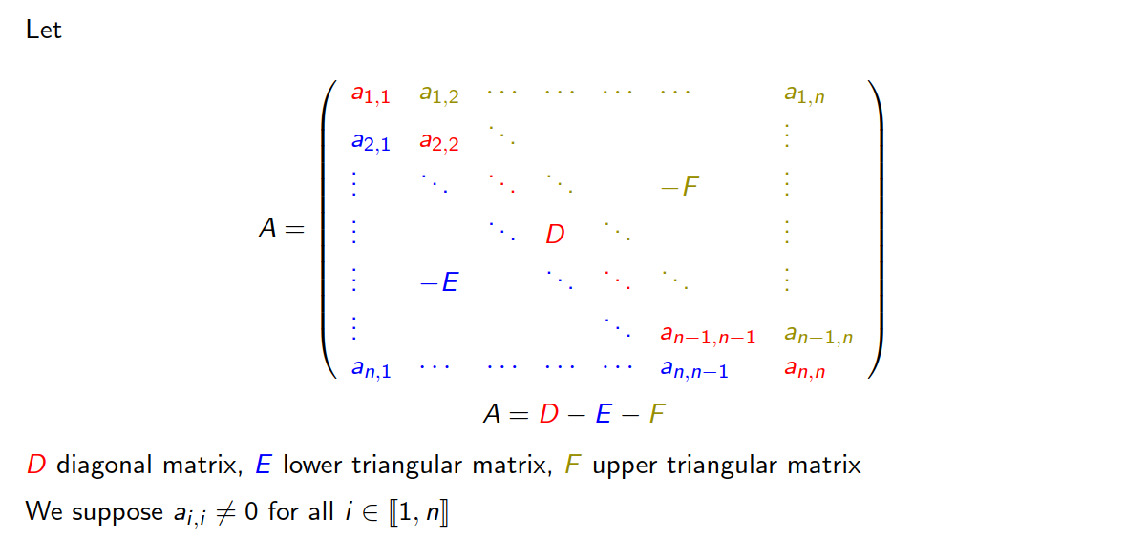
Towards a decomposition of A

Slide 44
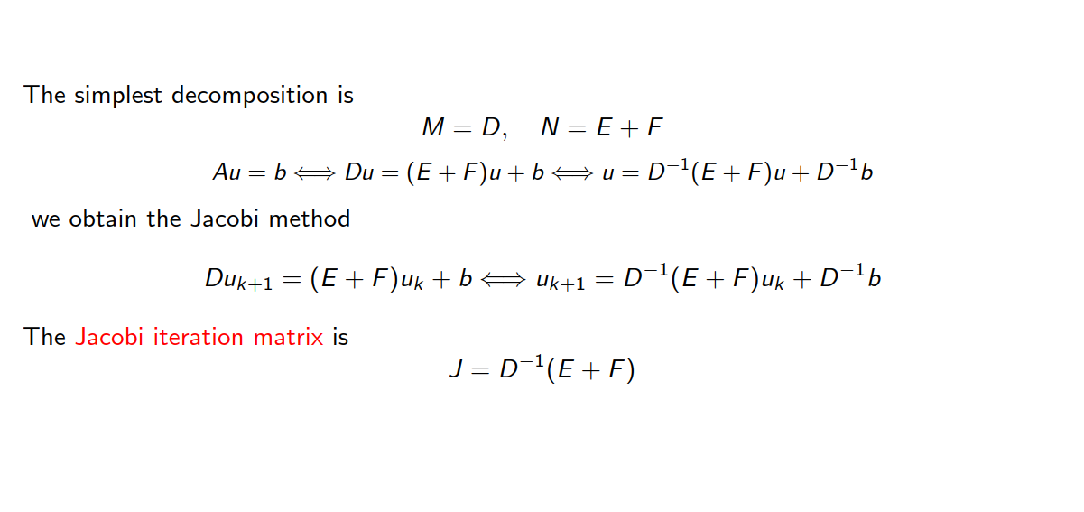
Jacobi iterative method

Slide 45
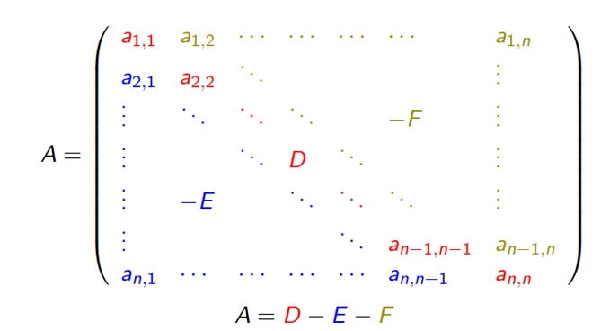
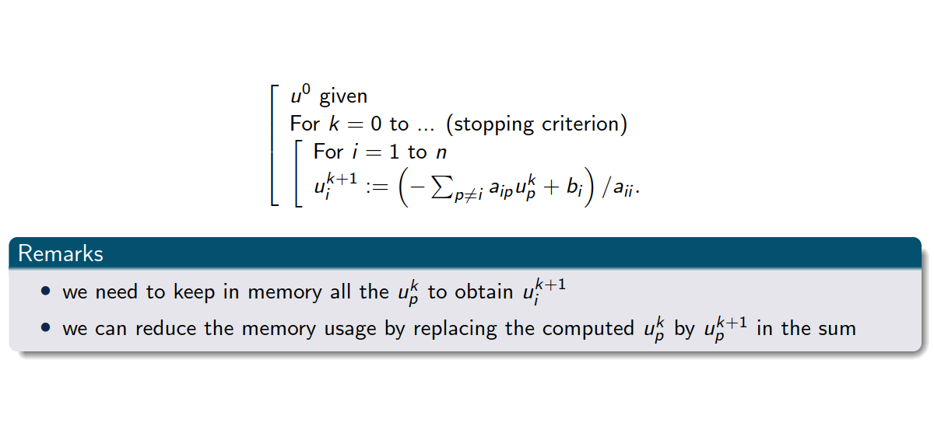

Jacobi iterative method
Pseudo code

Slide 46
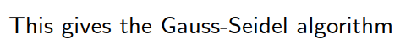

Gauss Seidel algorithm
Pseudo code

Slide 47
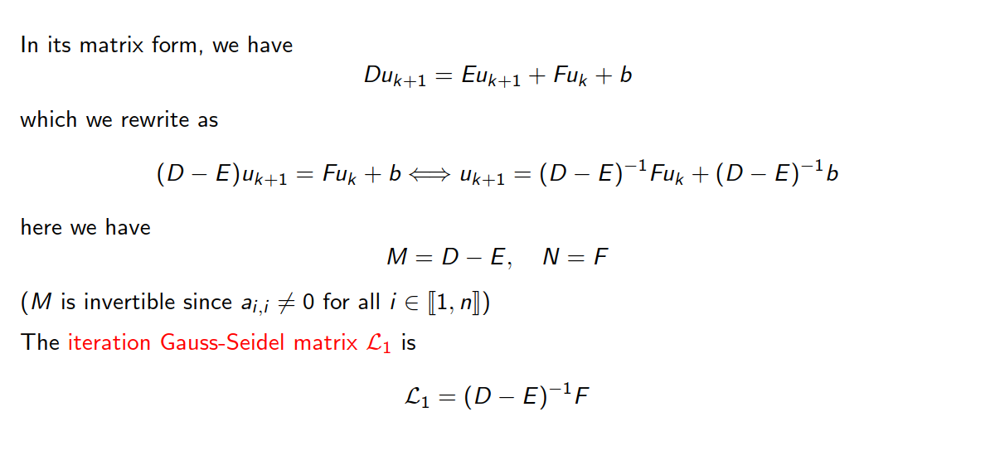
Gauss-Seidel iterative method

Slide 48
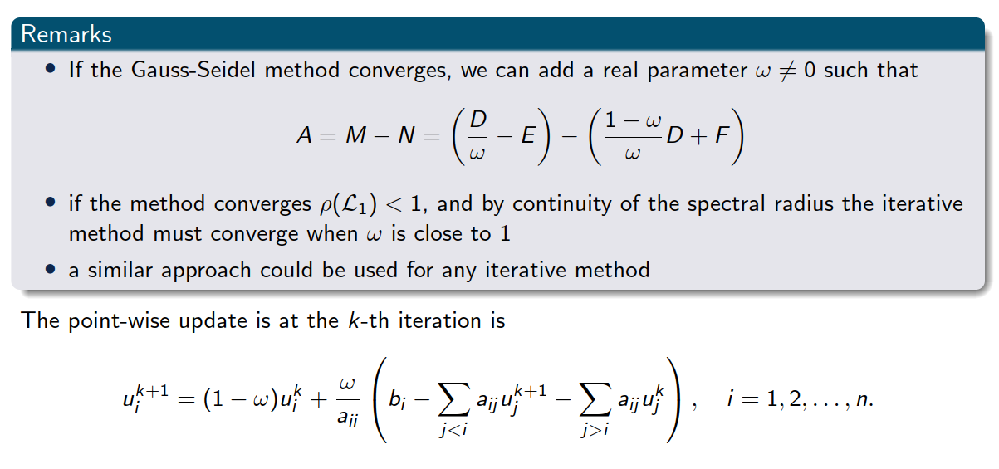
Relaxation method: Successive over-relaxation (SOR)

Slide 49











Relaxation method: Successive over-relaxation (SOR)

Slide 50
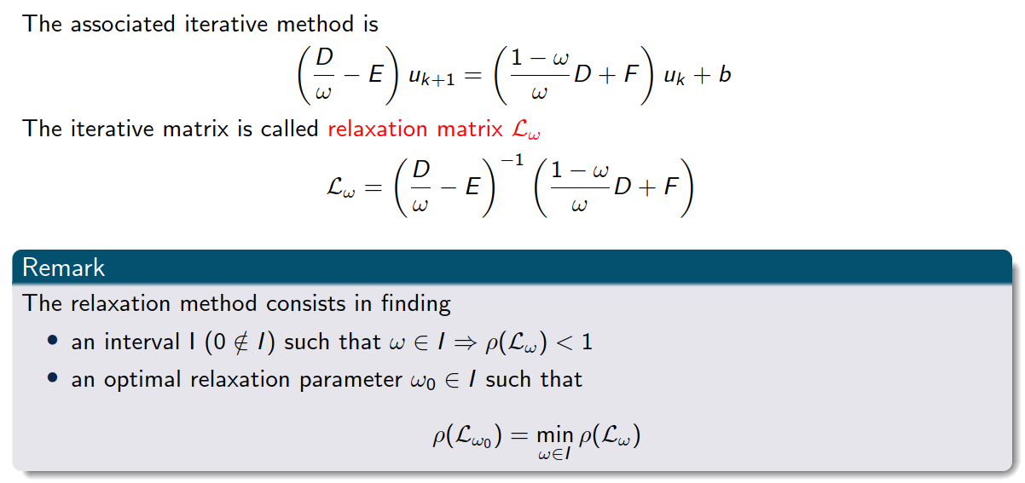
Relaxation method: Successive over-relaxation (SOR)

Slide 51
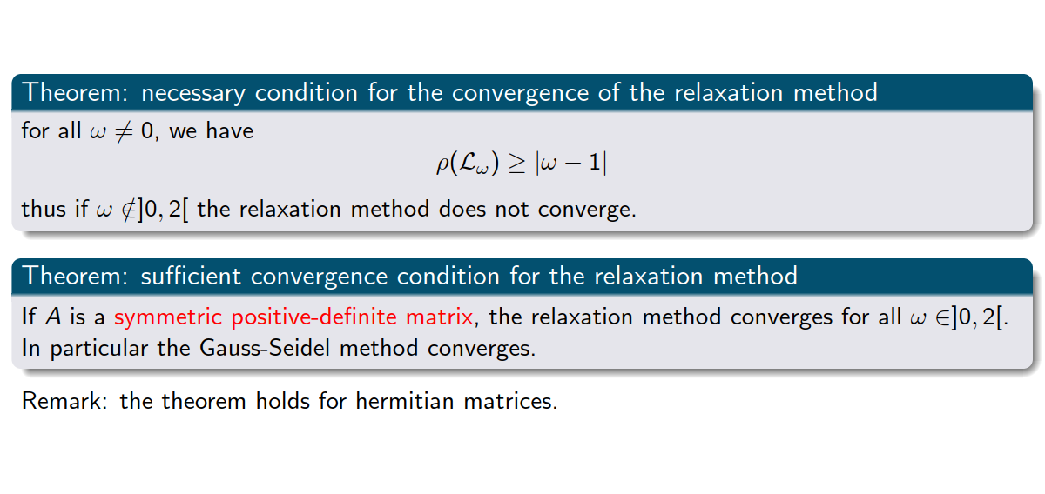
Convergence of SOR

Slide 52
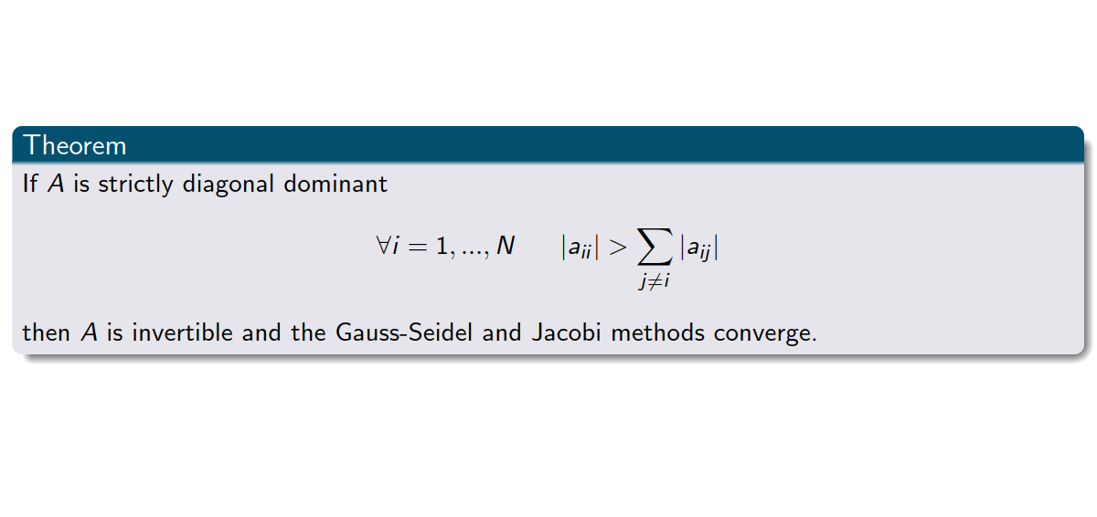
Convergence of Gauss-Seidel and Jacobi

Slide 53
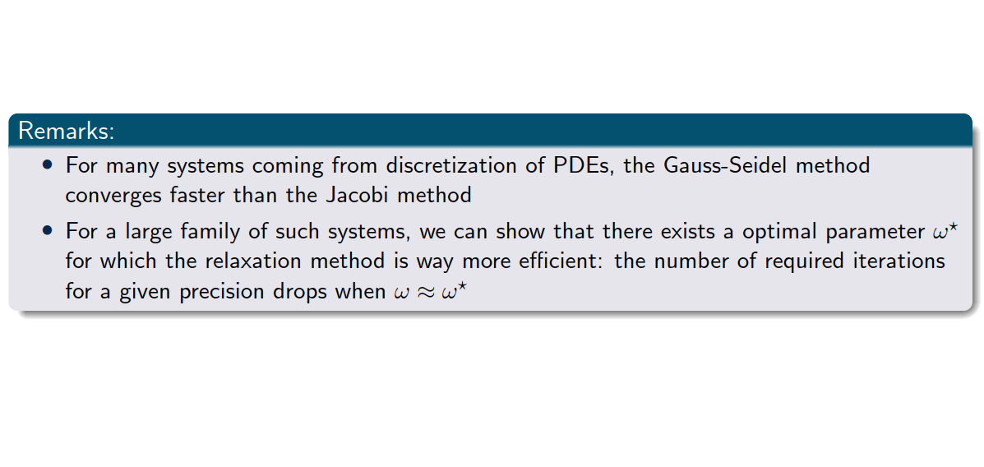
In general

Slide 54
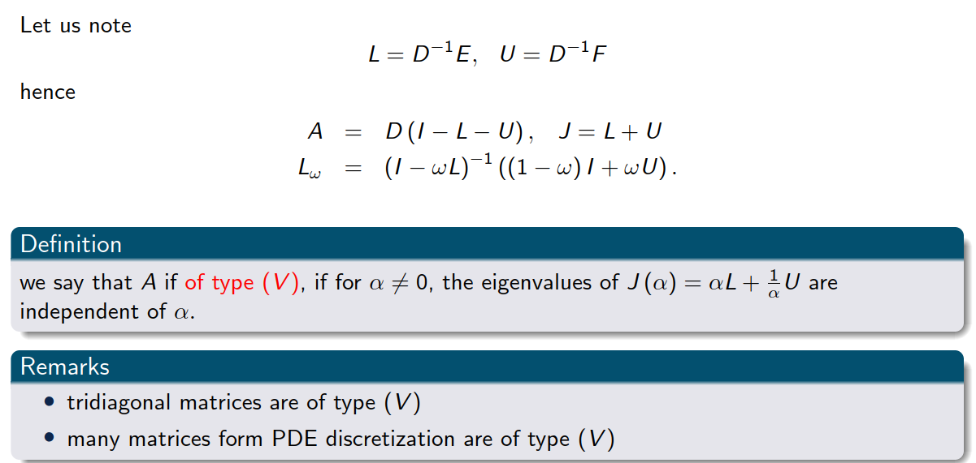
Matrices of type “V”

Slide 55
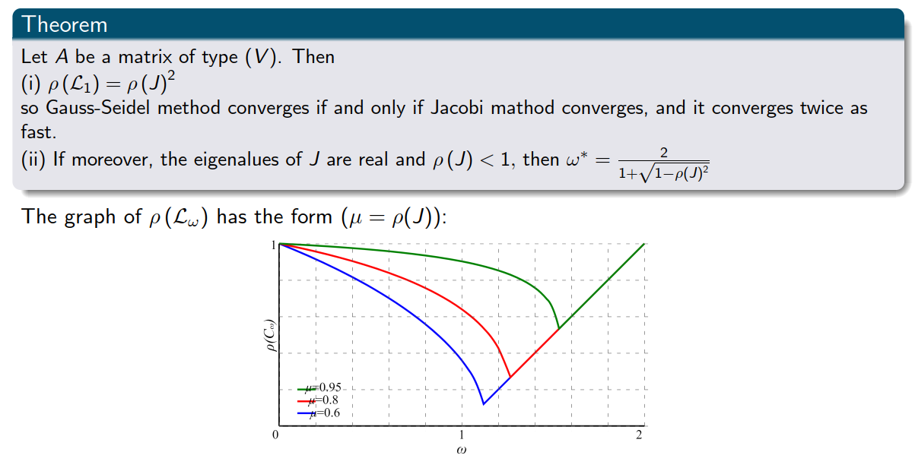
Matrices of type “V”

Slide 56

A few words about conditioning

Slide 57

A few words about conditioning
Exercise 5

Slide 58
6. Summary

Slide 59

Summary

